Slide 1



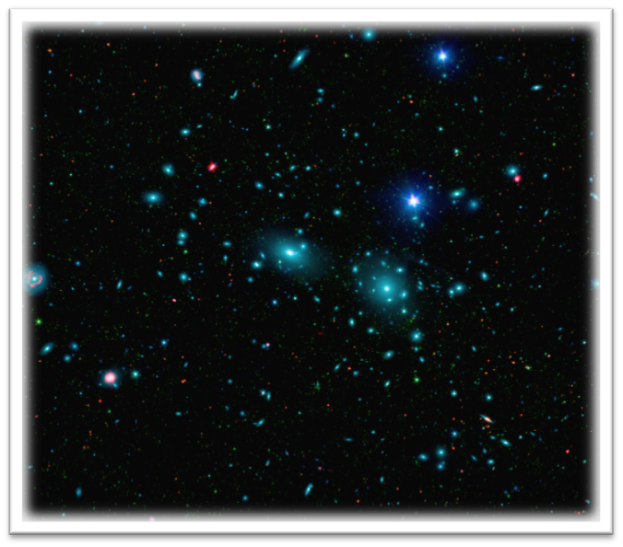
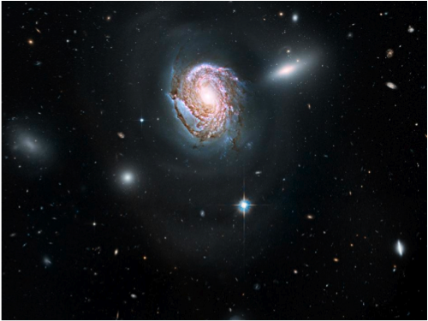
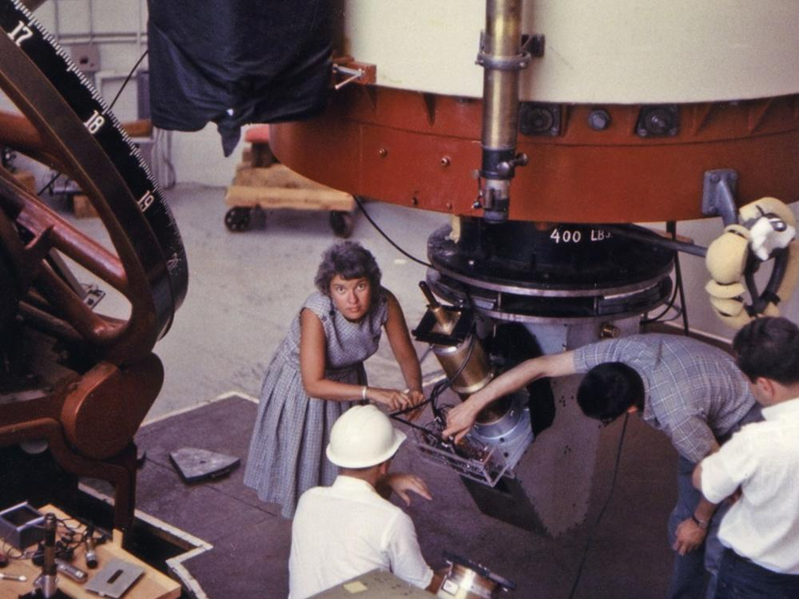
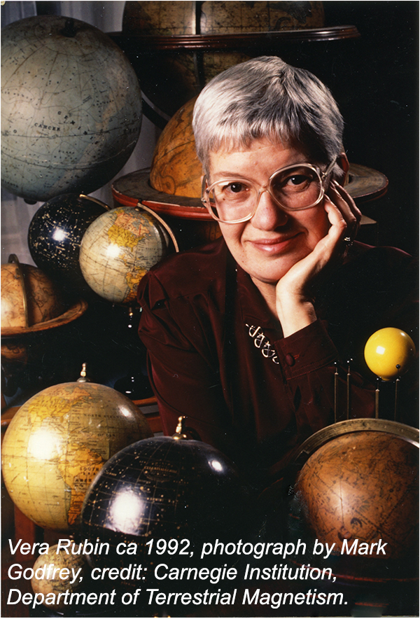
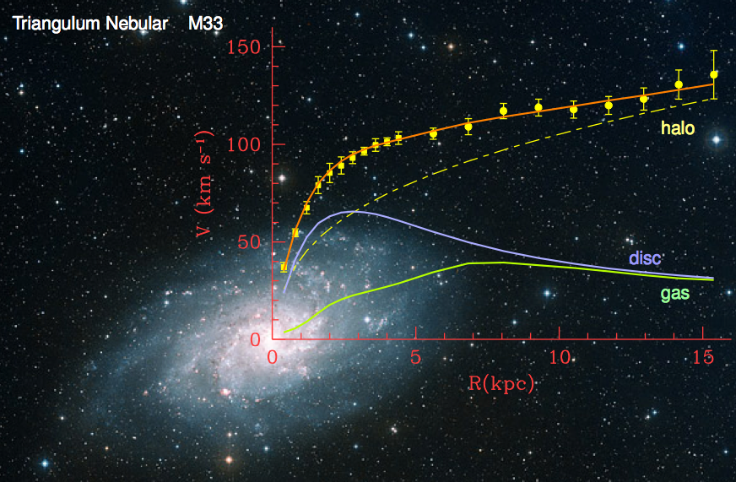
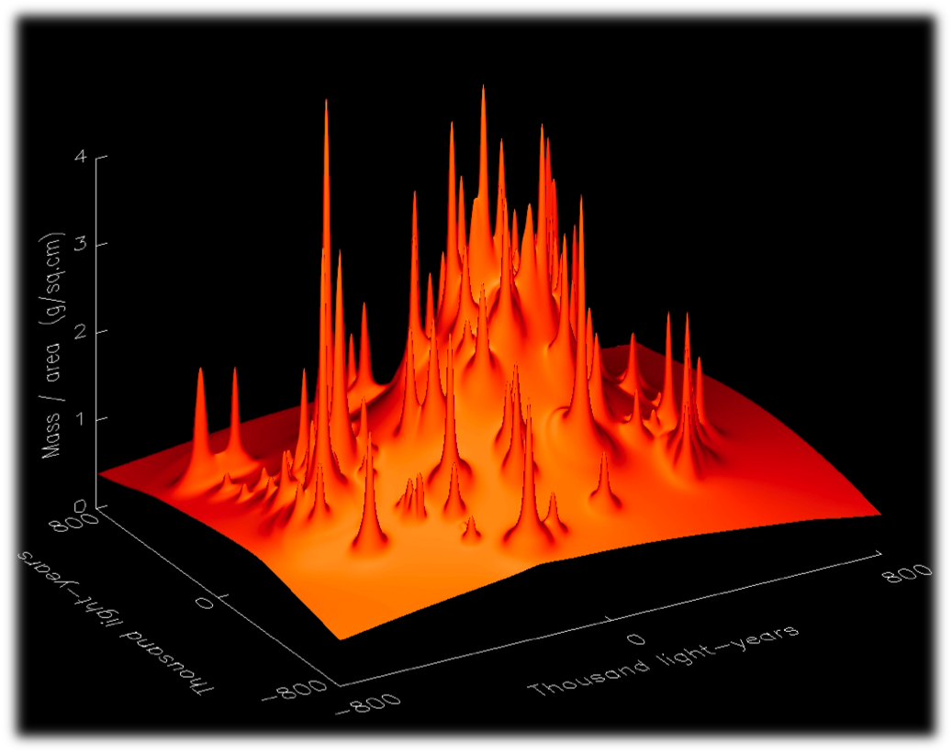
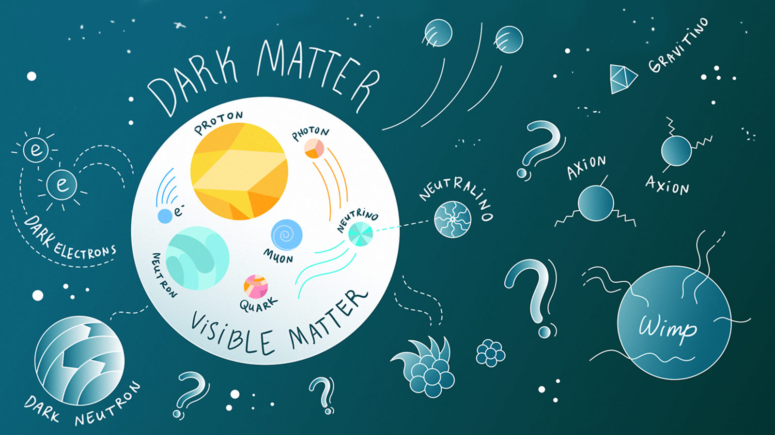
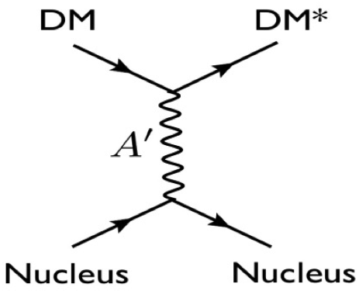
What is Dark Matter?
Thomas Jefferson National Accelerator Facility
First Evidence: Zwicky and the spherical insult
Vera Rubin and ionized clouds
Left: the COMA cluster, containing over 1,000 identified galaxies. One of them is NGC 4911, on the right.
In 1933, Fritz Zwicky was the first to infer the existence of unseen matter. He analyzed over 400 galaxies in the COMA cluster and noticed that they moved 50 times faster than calculated based on their mass. The implications were astonishing: something unknown and enormous was accelerating them.
These results were regarded with a healthy amount of skepticism for decades. It didn’t help that Zwicky was quite a character, furious with anyone not agreeing with him. He accused Hubble of being a “sycophant” and was not allowed to use the Mount Palomar telescope until late in his career.
Top left: Vera Rubin working at the 183-centimeter (72-inch) Ohio Telescope in Flagstaff. Right: Vera Rubin in 1992 at Carnegie Institution, Department of Terrestrial Magnetism.
Right: plot from her ’s 1970 article, regarded as the first smoking gun evidence of dark matter.
Zwicky coined the word “spherical bastard” to address people who disagreed with him. A spherical bastard is a bastard, no matter how you look at them.
Vera Rubin in the ’60s and ’70s was measuring the movement of ionized hydrogen clouds in many galaxies around the cosmos.
Naturally, we expect that these clouds slow down as their distance from the center of the galaxies increases.
Vera found that not only do the clouds not slow down, but in many cases their speed even increased a little!
Rubin’s work was the first clear, observational evidence for dark matter.
More Evidence: Centrifugal Force and Gravitational Lensing
Did you know?
Clusters of galaxies produce a significant dent in the fabric of space-time: They are powerful optical lenses.
Just like an everyday lens, they enlarge, distort, and duplicate images of the same object.
In the top picture the cluster CL 0024 (yellow bright objects) is a powerful lens system (119 lenses in fact) and the same galaxy is seen 5 times.
Computer simulations consider the total mass of all the lenses, as well as the shape, orientation, and mass of the single galaxies, to produce a model of the lens, as seen in the bottom picture.
The individual peaks are the known galaxies. But wait: there’s a hill where all the lenses sit… and what is that huge mountain in the middle?
Over 2 million models were tried, and they all came up with the same result: there is something invisible. And that is what we call dark matter.
Dark Matter makes up a quarter of the mass of the Universe. Without it, galaxies would fall apart, and stars would spin off into space.
Several experiments are searching for Dark Matter. Some may even have already recorded signals. The problem is that no experiment has been able to make that claim with enough confidence to convince the wider scientific community – either due to statistics or an inability to rule out alternative possible explanations.
Dark Matter doesn’t interact much with itself or anything else. If it did, it would slow down and clump too much, which wouldn’t be in agreement with the observational data.
Dark Matter is responsible for the structures in the Universe: it is responsible for the filaments along which galaxies later form.
Dark Matter doesn’t interact enough to form objects as dense as planets, but it does have ‘halos’ of varying density that move around in galaxies.
Yellow points: the rotation curve has been measured for over 1,000 galaxies in 2002. The gravitational force of the objects we see (blue and green lines) can account for only 10% of the total needed to describe the experimental data. This shows that dark matter amounts for 90% of the galaxies’ mass.
The Hunt is On at Jefferson Lab Too.
Is dark matter made of dark photons?
Top: the suggested mechanism is that Dark Matter interacts with ordinary matter, through a Dark Photon A’ (also called Heavy Photon).
Bottom: how we can “produce” Dark Photons at JLab. We direct the JLab high intensity electron beam into a very dense target (we will use Tungsten). This will maximize our chances of producing dark photons. Those will decay into an electron/positron pair that can be detected in Hall-B with the Heavy Photon Search (HPS) setup.
So, what is dark matter? We do not really know yet! Scientists have produced several models for what dark matter might be like. Some think it’s made of WIMPs, Weakly Interacting Massive Particles. Other possibilities include particles conveniently already predicted in models of supersymmetry. Groups of scientists are also searching for dark-matter particles called axions. At Jefferson lab, we are looking for Heavy Photons, particles that have properties like ordinary light but have mass and are invisible.

